Slide 1


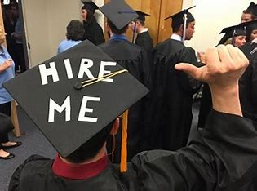
Writing Professional Emails
Lesson 3: 18/11/2022
Graph Description Review
TP: Graph Description in Class and on Paper
Writing Emails

Slide 3
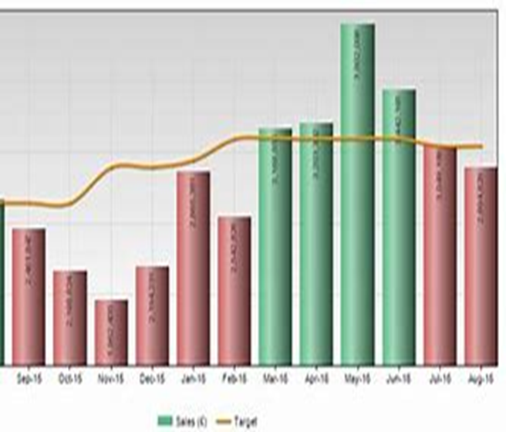
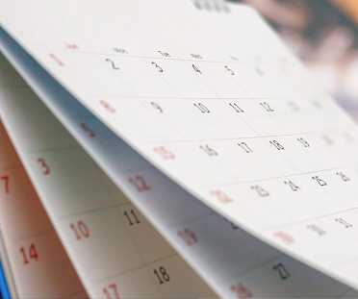
Graph Description Review
Im
Graph Description Review
Questions
Revision
TP: Graph Description, in Class, on Paper

Slide 4

Practice Makes Perfect
Coffee Break

Slide 5
Date | Lesson | Theme | Learning Outcomes/Objectives | Theme/Activities/Skills targeted | Resources
18/11/22 | 3 | Writing Professional Emails | After completing this lesson students should be able to:- •Say Emails Correctly •Send and Receive Emails in English •Be familiar with different parts of an email •Be able to make arrangements on email using the •right grammar, vocabulary and syntax •Organise writing | Writing skills: Demonstrate understanding of how to write professional emails | British Council English: Writing Emails

Slide 6
How to Write Professional Emails
Im
Writing Emails
How to say them correctly
Sending and Receiving Emails
Organising Emails: Different Parts of an Email
Making Arrangements on Emails
Organising your Writing

Slide 7
Writing Emails - How to Say Them Correctly
Do you know how to say Emails correctly?
Every email address contains this sign: @ . Here are some email addresses:
bob@yahoo.bh
jeffery.amherst@britishcouncil.org
reservations@beachhotelbern.com
As you can see, Bob uses his first name only in his email address: bob@yahoo.bh. Jeffery Amherst uses his first name and surname in his email address: jeffery.amherst@britishcouncil.org. The address reservations@beachhotelbern.com gives the name of the department (Reservations), but not the name of the person.

Slide 8
Writing Emails - How to Say Them Correctly
When you say an email address:
Remember that @ is pronounced ‘at’ and . is pronounced 'dot'. reservations@beachhotelbern.com is ‘reservations at beach hotel bern dot com’
Sometimes there is a . in the person's name. jeffery.amherst@britishcouncil.org is ‘jeffery dot amherst at british council dot org’
_ in an email address is called ‘underscore’. teaching_ job@english_academy.id is ‘teaching underscore job at English underscore academy dot I D’.

Slide 9
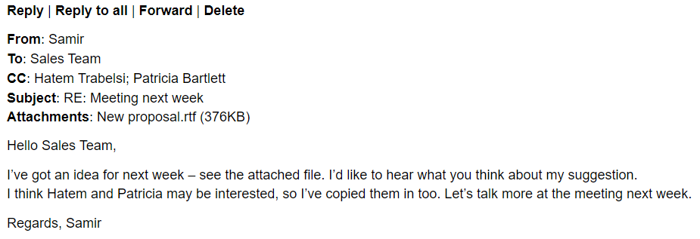
Writing Emails - Parts of an Email
Learn how to talk about the different parts of an email in English.

Slide 10
Writing Emails - Organising Your Emails
Activity: You've got mail! Learn how to talk about the different parts of an email program.
Fill in the blanks in the text below:
Most emails that you get go straight to your (1). This is where you decide which emails to read and which to delete. But if your server doesn’t recognise the address of a sender, it will probably put the email in the (2) mail folder. This is where all those annoying adverts usually go. But sometimes good emails go there too, so remember to check from time to time.
Do you ever worry because you just deleted an email by mistake? Don’t worry – just look in the (3) folder. It’s probably still there. Sometimes it can be difficult to find an old email. So why not put them into (4) to make them easy to find? You can do this for any emails you wrote too – you can find them in (5).
Some people keep hundreds of business cards with people’s email address and phone number. You don’t need to do this – use your (6) as an address book, and it can store all these details for you. Have you ever found it difficult to finish writing an email? Don’t worry – just save it under (7) and finish it later!

Slide 11
Writing Emails - Organising Your Emails
Activity: You've got mail! Learn how to talk about the different parts of an email program.
Fill in the blanks in the text below: Answers
Inbox
Junk mail /spam
Deleted/Trash
Folders
Sent
Contacts
Draft

Slide 12
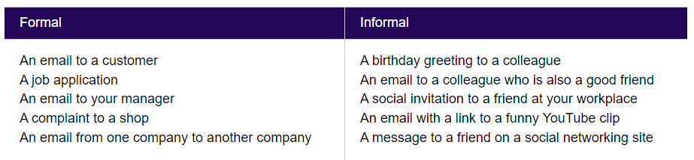
Writing Emails - Starting and Finishing Emails
Formal or informal?
We write a formal email when we want to be polite, or when we do not know the reader very well. A lot of work emails are formal. We write informal emails when we want to be friendly, or when we know the reader well. A lot of social emails are informal. Here are some examples of formal and informal messages:

Slide 13
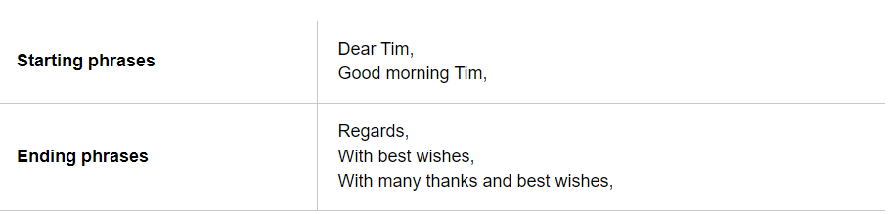
Writing Emails - Starting and Finishing Emails
Phrases for starting and finishing
Here are some phrases which we use for starting and finishing emails. We use these in formal and informal emails:

Slide 14
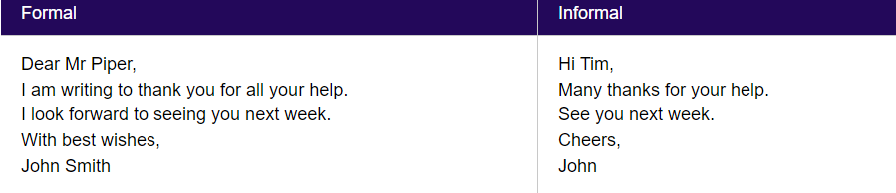
Writing Emails - Starting and Finishing Emails
Before you start writing an email, decide if you want to write a formal email or an informal one.
Layout and punctuation
Starting an email: We normally write a comma after the opening phrase. We start a new line after the name of the person we’re writing to.
Finishing an email: We normally write a comma after the closing phrase. We start a new line to write our name at the end.

Slide 15
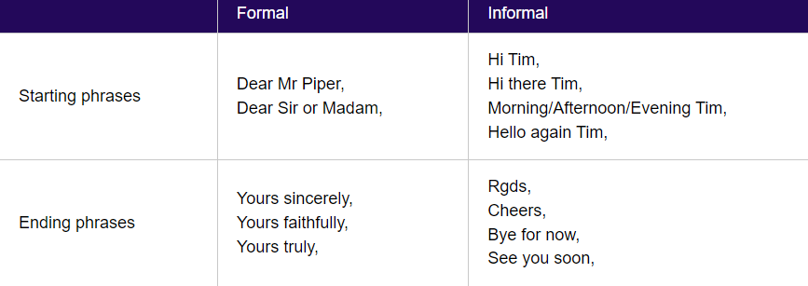
Writing Emails - Starting and Finishing Emails
Phrases for starting and finishing
You also need to know which phrases to use only in a formal email or an informal one:

Slide 16
Writing Emails - Making Arrangements
Think about these points when the purpose of your email is to make an arrangement.
Useful questions
Here are some typical questions used for making arrangements:
Are you free next Tuesday afternoon?
What time would you like to meet?
When would be convenient for you?
Could you please let me know?
Expressions of time
Use on with days: Could we meet on Monday?
Use in with months, years and other expressions: I'm going to visit my grandparents in October.
Use at with times and other expressions: Could you please call me at 3pm?
Use next to refer to future times: I hope we can meet again next week.
Use when to start a future time clause: Let's meet again when it is convenient.

Slide 17
Writing Emails - Making Arrangements
Tenses
To speak about a timetable, use the present simple: Next term runs from 1 September until 16 December.
To speak about a future arrangement, use the present continuous: Mr Toshiko is coming to our next meeting.
To speak about a plan, use 'be going to': Next term we are going to learn about pollution.
Tenses in complex sentences about the future
Use the present simple after when, if and next time in future time clauses:
I will call you when I get to the station.
I'm going to work with my dad when I finish school.
Let's go for a walk if the weather is good.
Will you visit the Eiffel Tower next time you are in Paris?

Slide 18
Writing Emails - Organise Your Writing
Make your emails clear and easy to understand by properly organising them.
Organising your writing
The people you write to will understand well-organised emails much more easily.
Writer purpose
When you write an email, you need to make clear why you are writing. You can do this by using the phrase 'I am writing to (+ verb)' at the start of your email. Here are some examples:

Slide 19
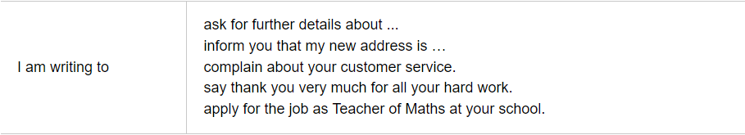
Writing Emails - Organise Your Writing
Make your emails clear and easy to understand by properly organising them.
Organising your writing
The people you write to will understand well-organised emails much more easily.
Writer purpose
When you write an email, you need to make clear why you are writing. You can do this by using the phrase 'I am writing to (+ verb)' at the start of your email. Here are some examples:

Slide 20

The End.
Thank you for your time

